Slide 1
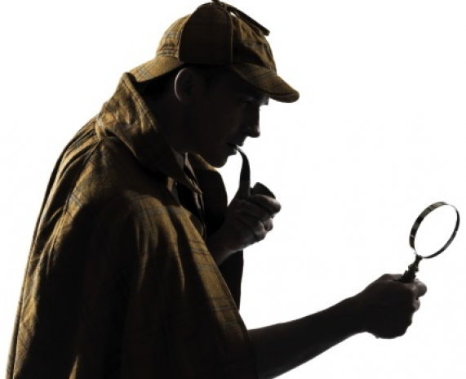
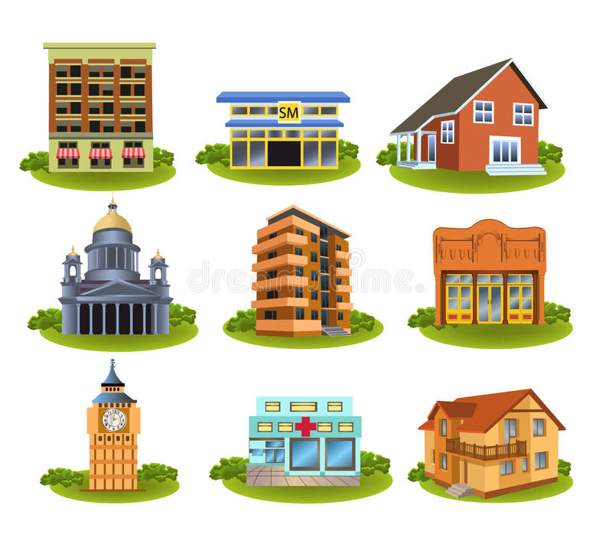
Where were you yesterday?

Slide 2
Public Places

Slide 3
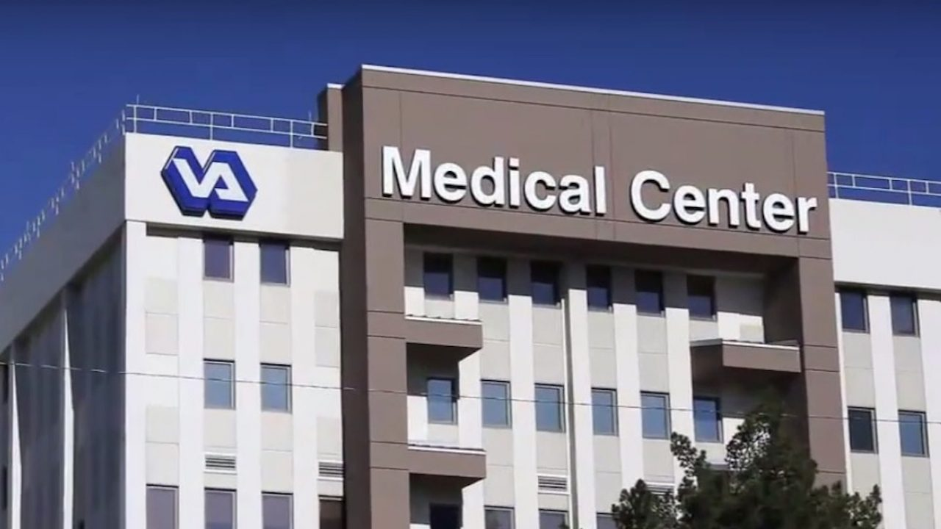
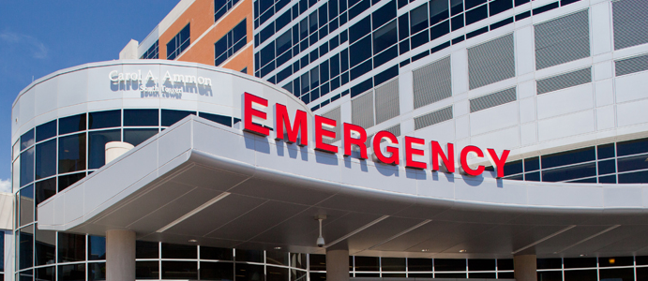
hos∙pi∙tal
hospital

Slide 4
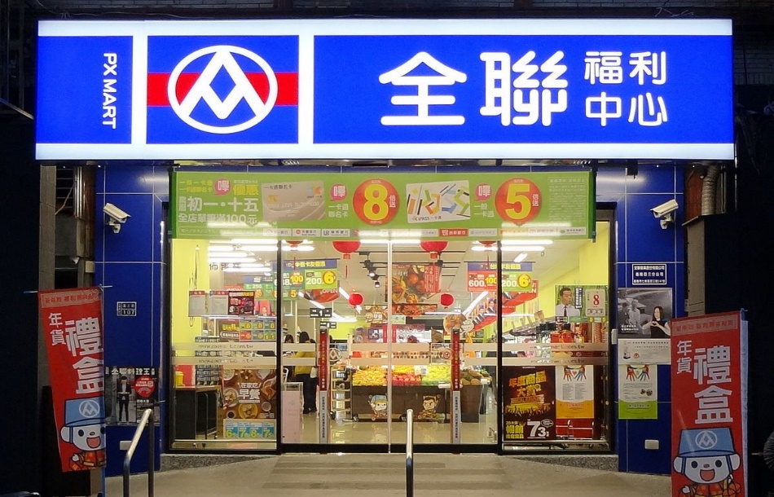
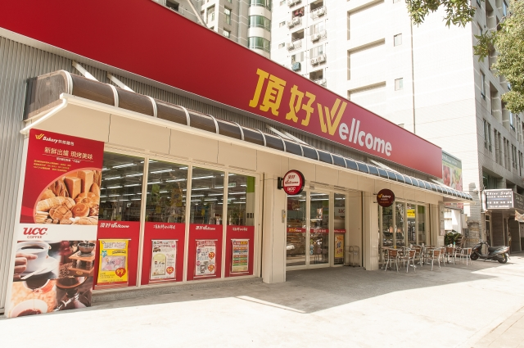
su∙per∙mar∙ket
supermarket

Slide 5
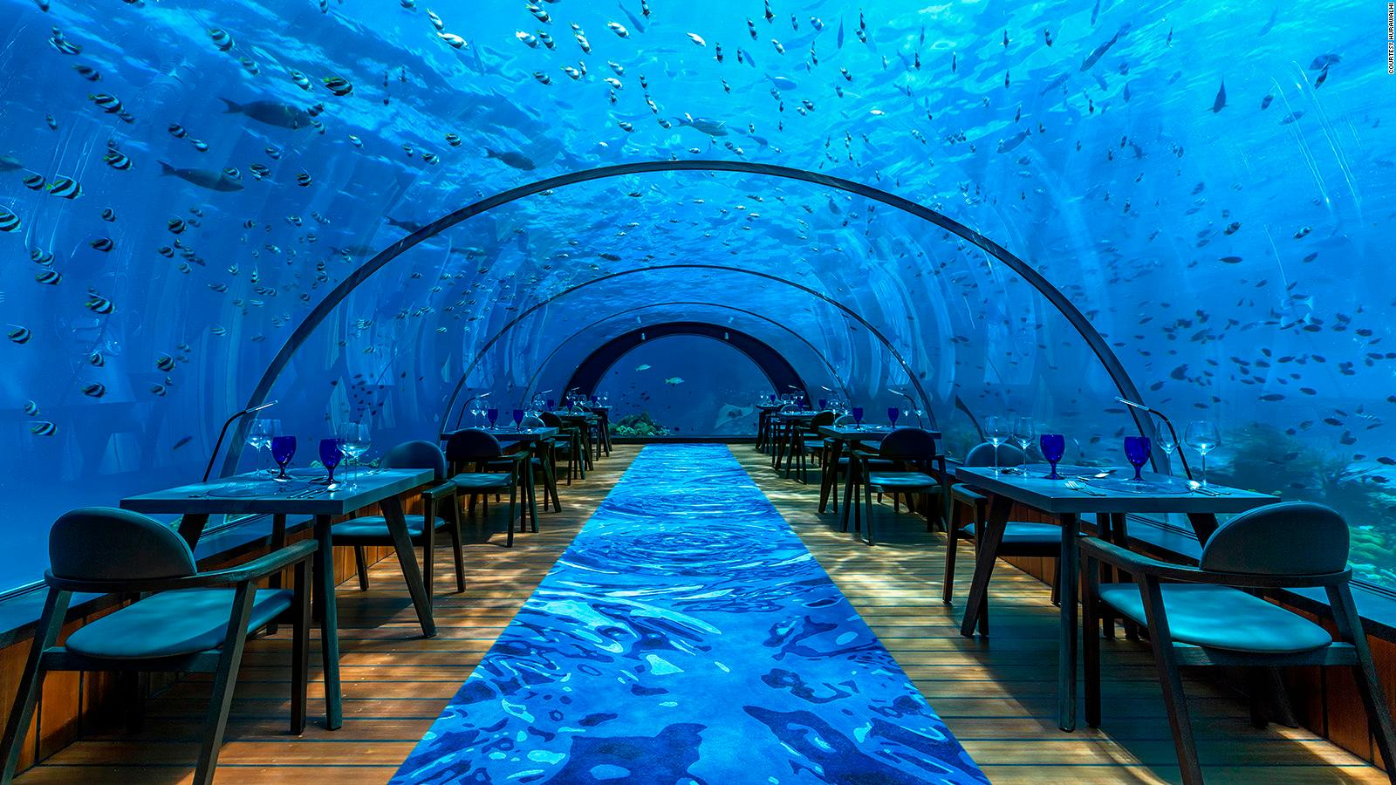
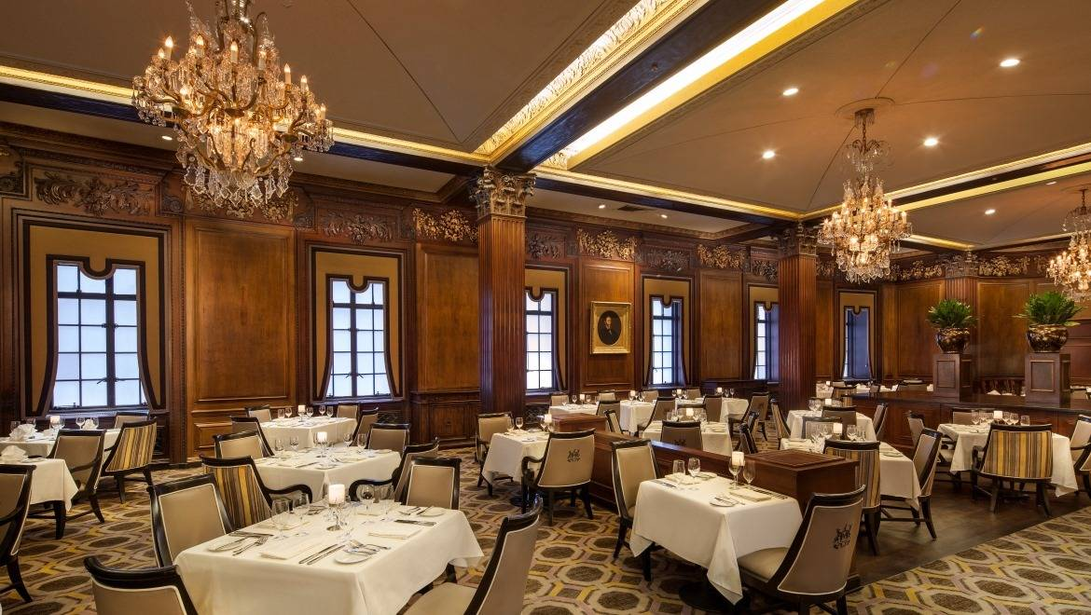
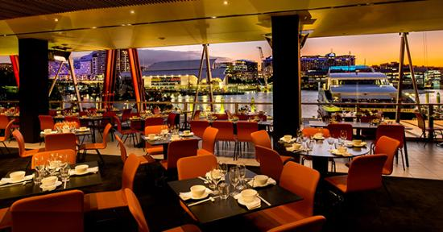
res∙tau∙rant
restaurant

Slide 6
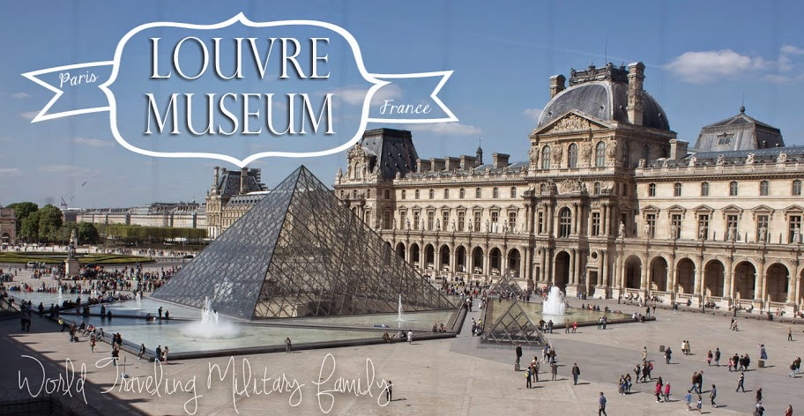
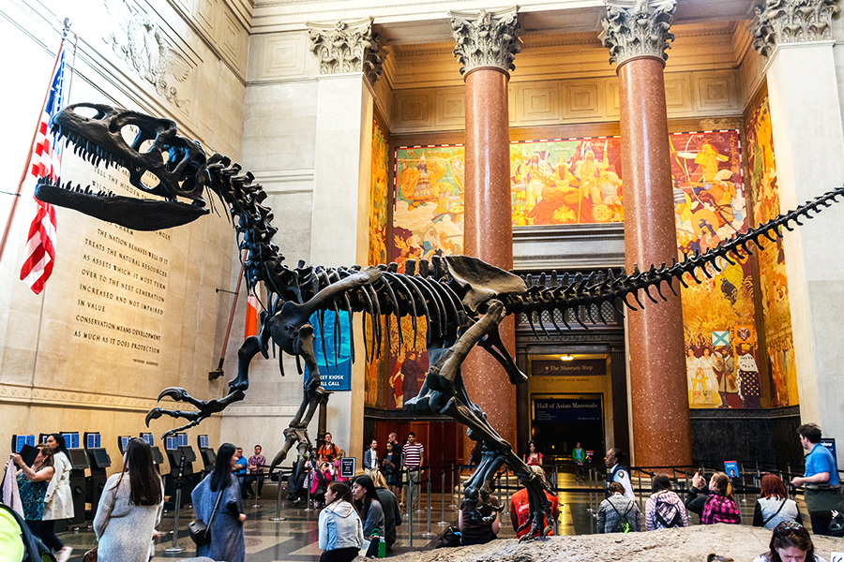
mu∙se∙um
museum

Slide 7
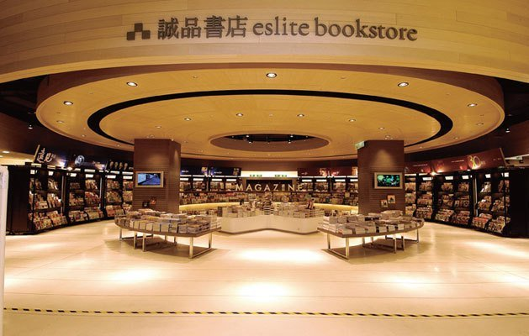
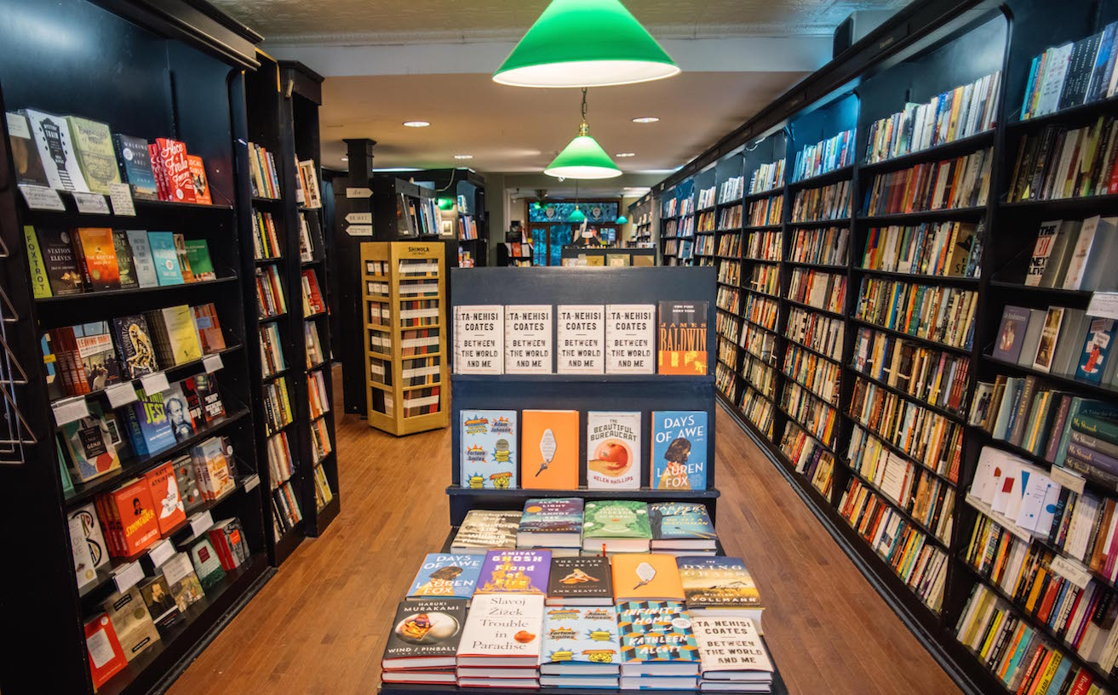
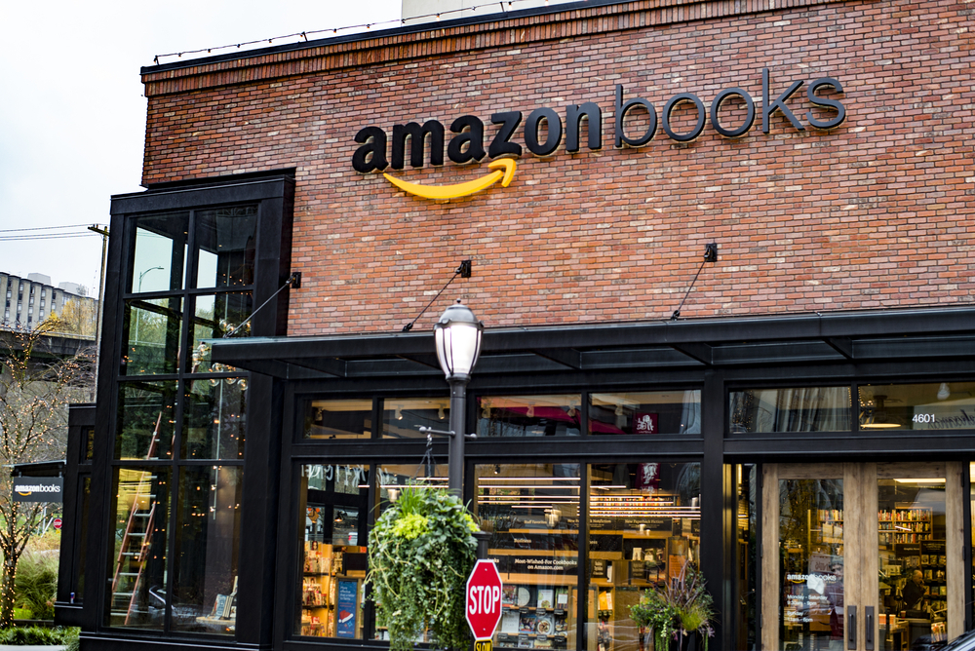
book∙store
bookstore

Slide 8
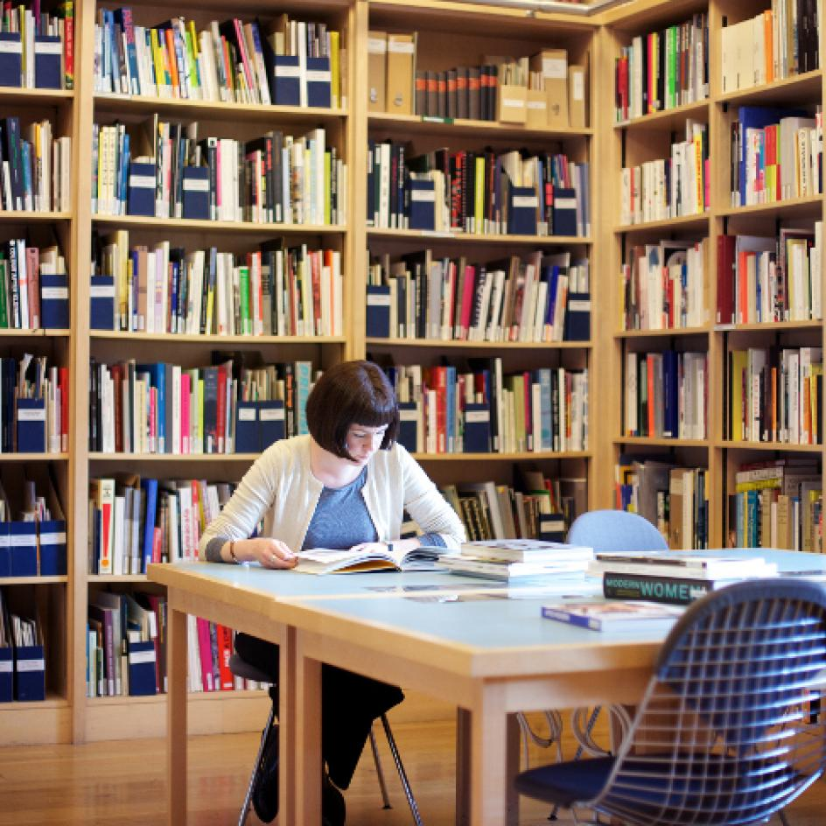
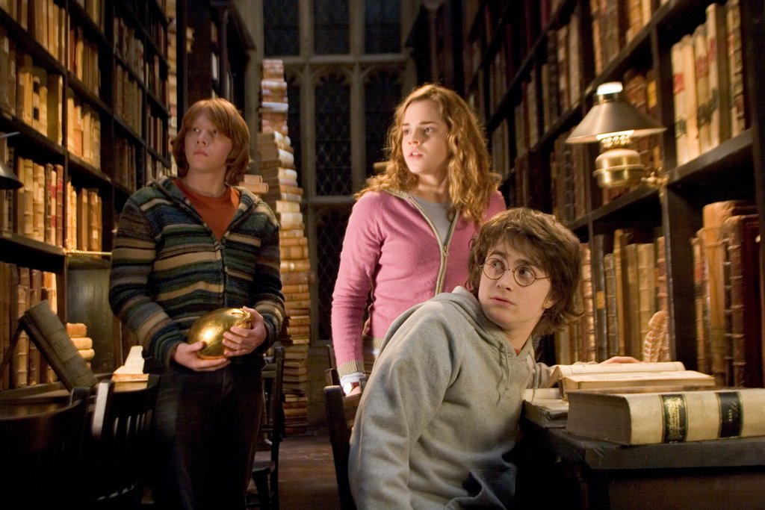
li ∙ bra ∙ ry
library

Slide 9
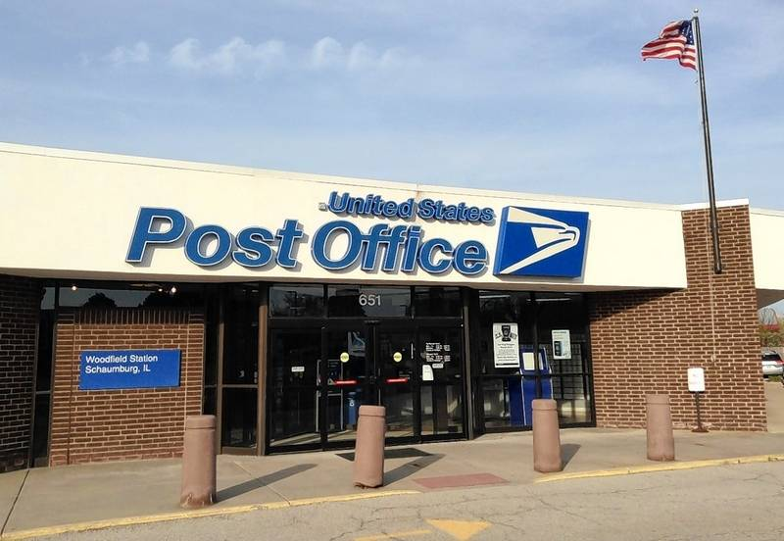
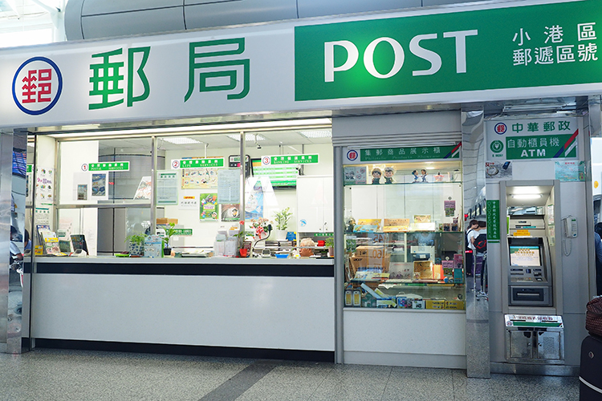
post office
post office

Slide 10
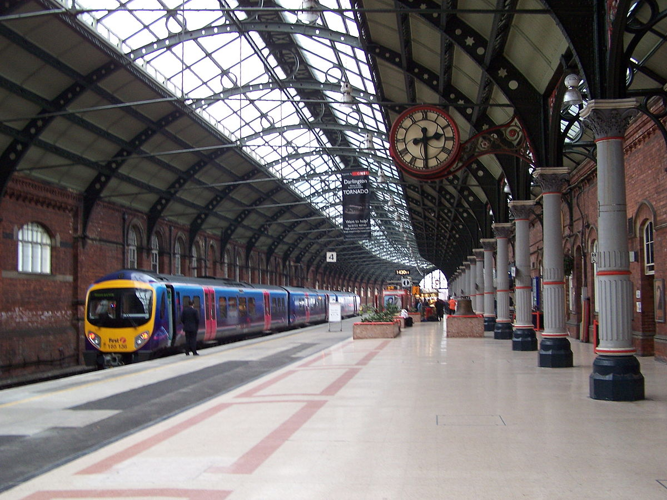
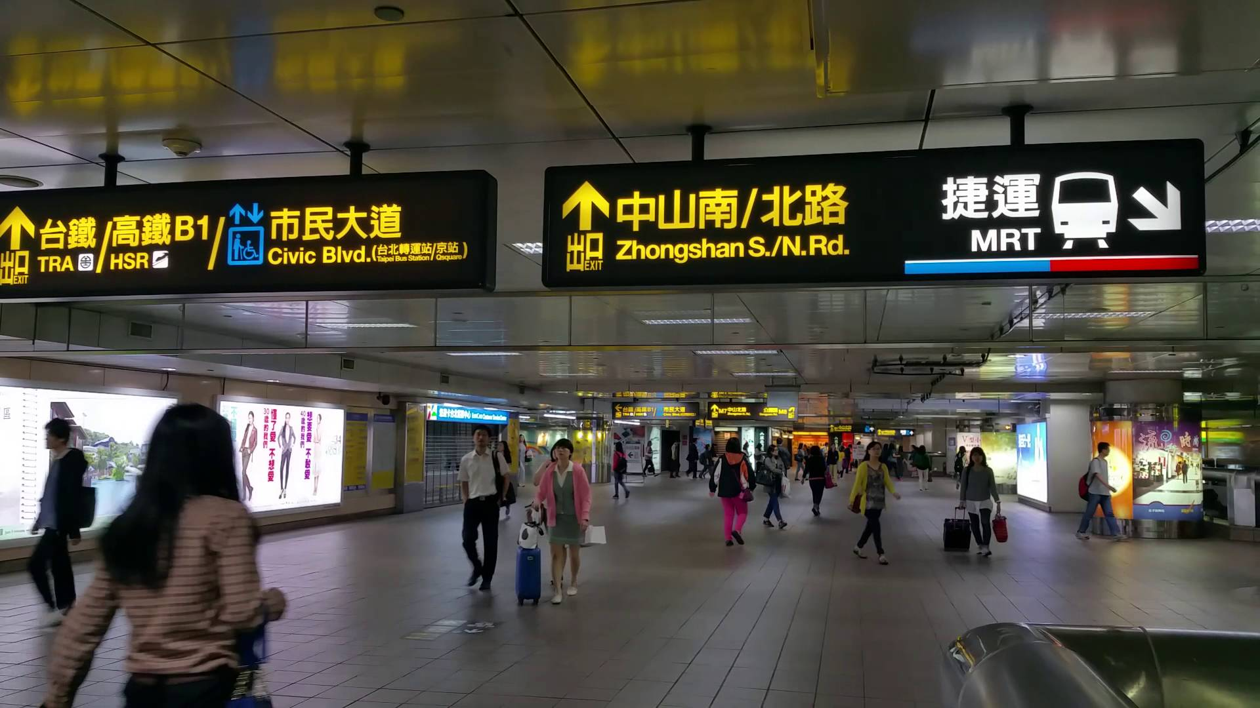
train station
train station

Slide 11
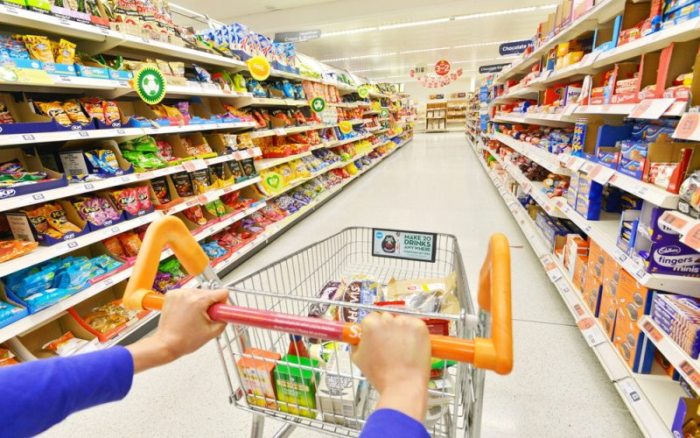
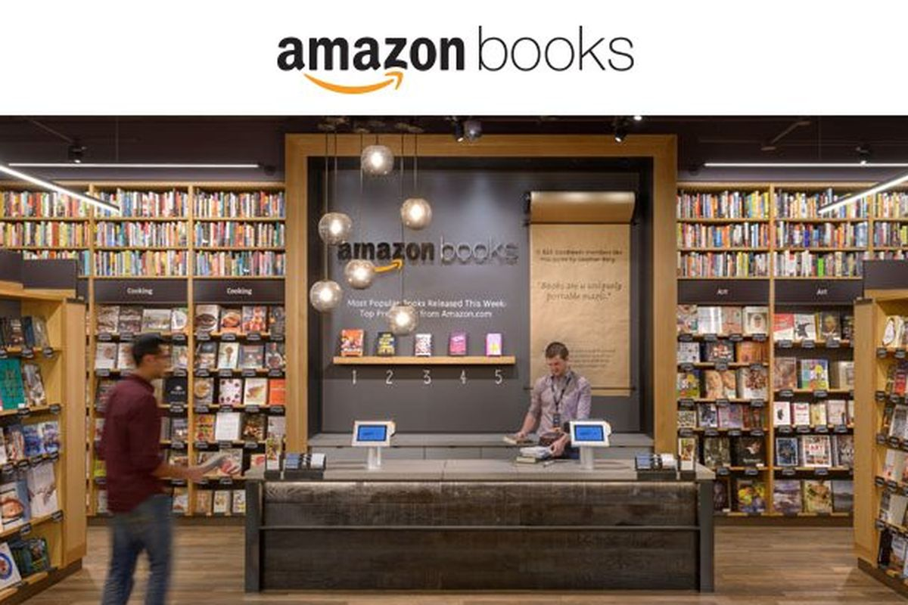
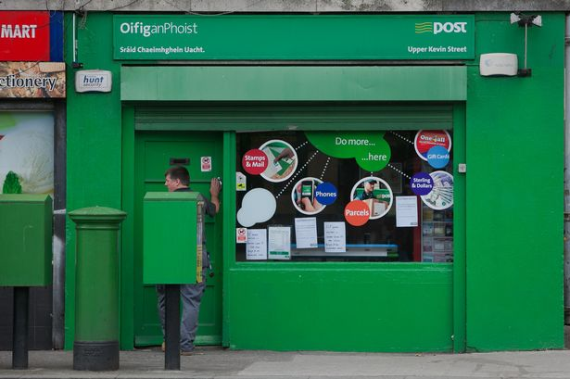
supermarket
3
museum
1
2
restaurant
4
hospital
post office
8
5
7
bookstore
6
library
train station

Slide 12
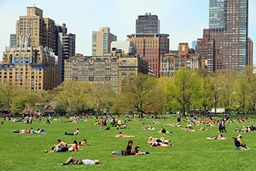
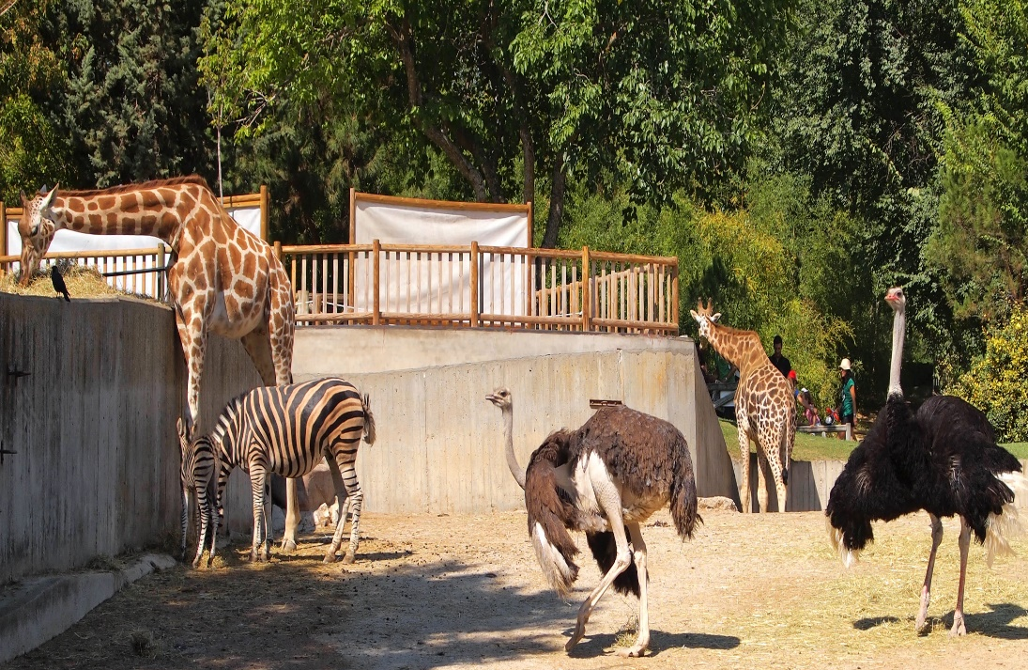
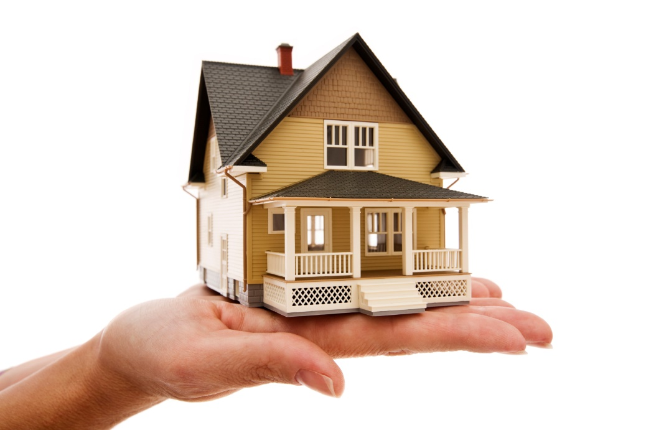
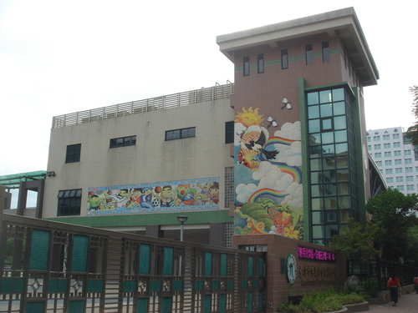
Review the words you learned before.
zoo
park
home
school

Slide 13
at the……
at home/school

Slide 14
supermarket
3
museum
1
2
restaurant
4
hospital
post office
8
5
7
bookstore
6
library
train station

Slide 15
park
zoo
home
school

Slide 16
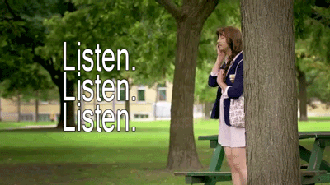

Slide 17
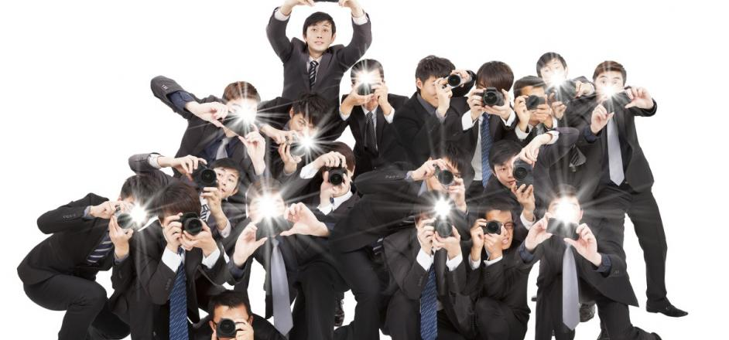
Let’s be paparazzi.

Slide 18
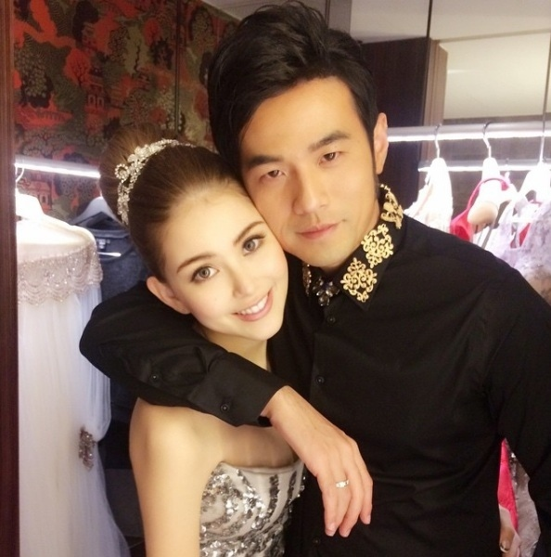
Hannah is Jay Chou’s wife.
現在式

Slide 19
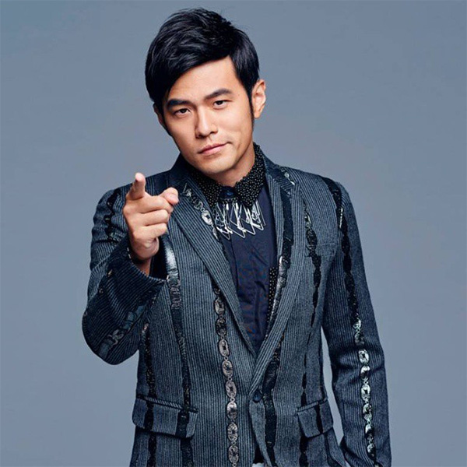
Jolin was Jay Chou’s girlfriend.
過去式

Slide 20
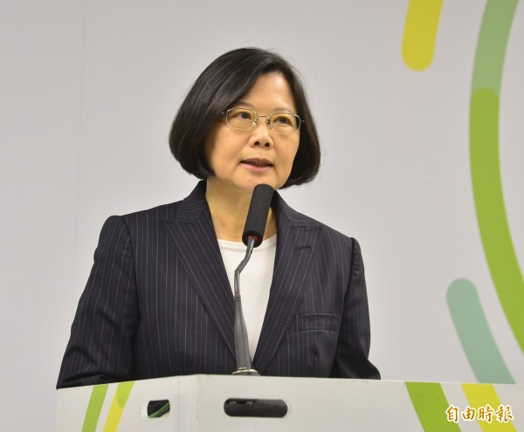
Ing-wen Tsai is Taiwan’s
president.
現在式

Slide 21
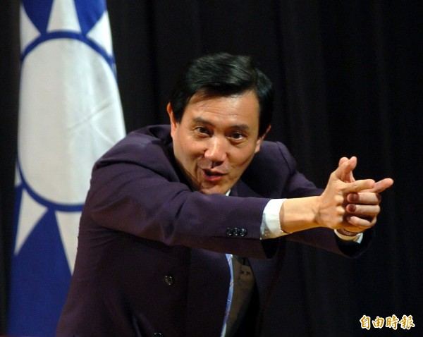
Ying-Chiu Ma was Taiwan’s president.
過去式

Slide 22
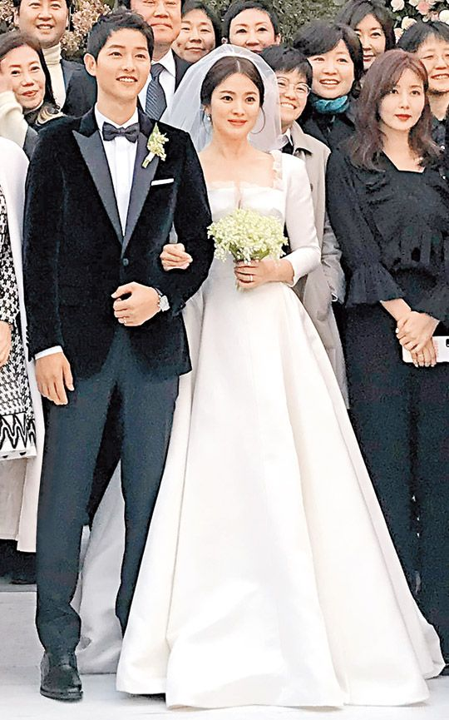
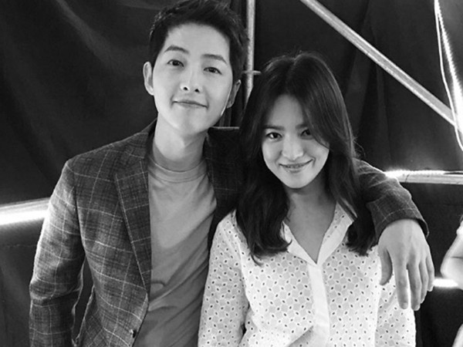
Joong-ki Song is Hye-Gyo Song’s husband.
現在式

Slide 23
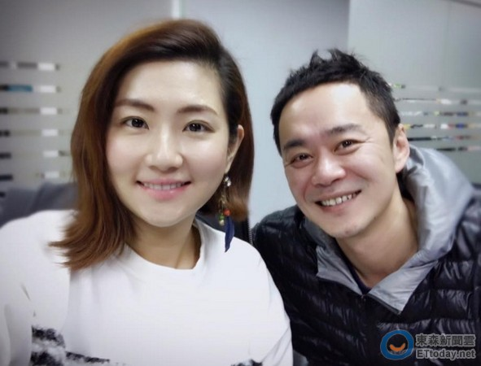
Chang Cheng-Zhong was Selina’s husband.
過去式

Slide 24
是
使用的Be動詞大不同
現在式(present tense)
過去式(past tense)
I am …
You are …
He is …
She is …
We are …
They are …
I was …
You were …
He was …
She was …
We were …
They were …

Slide 26
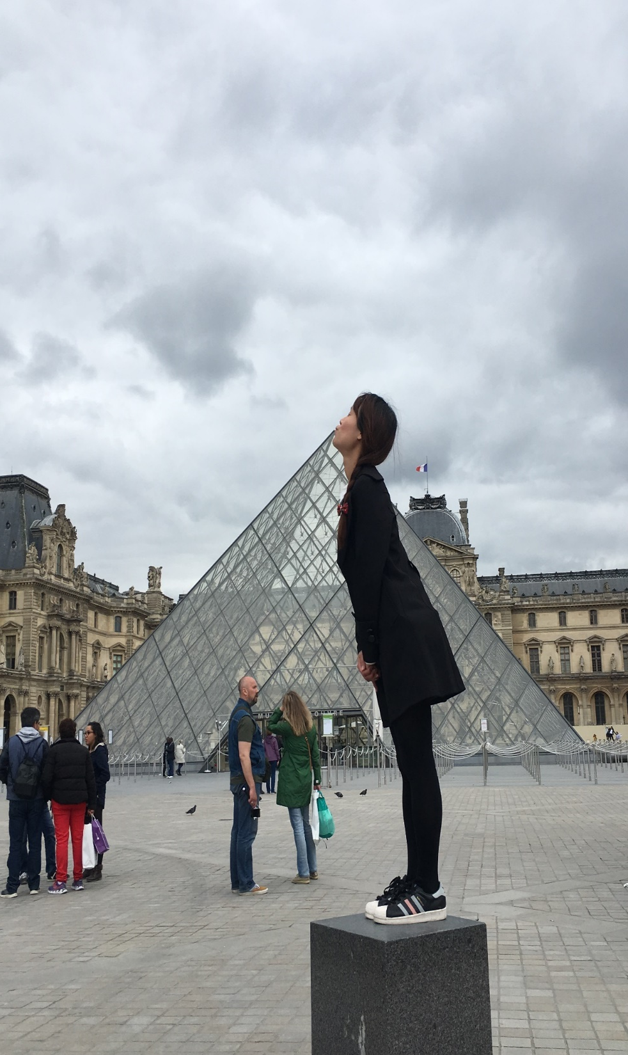
I was
at the museum yesterday.

Slide 27
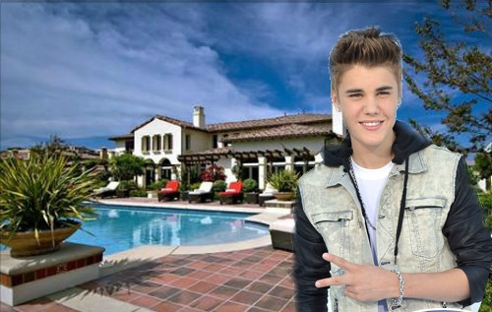
He was
at home yesterday.

Slide 28
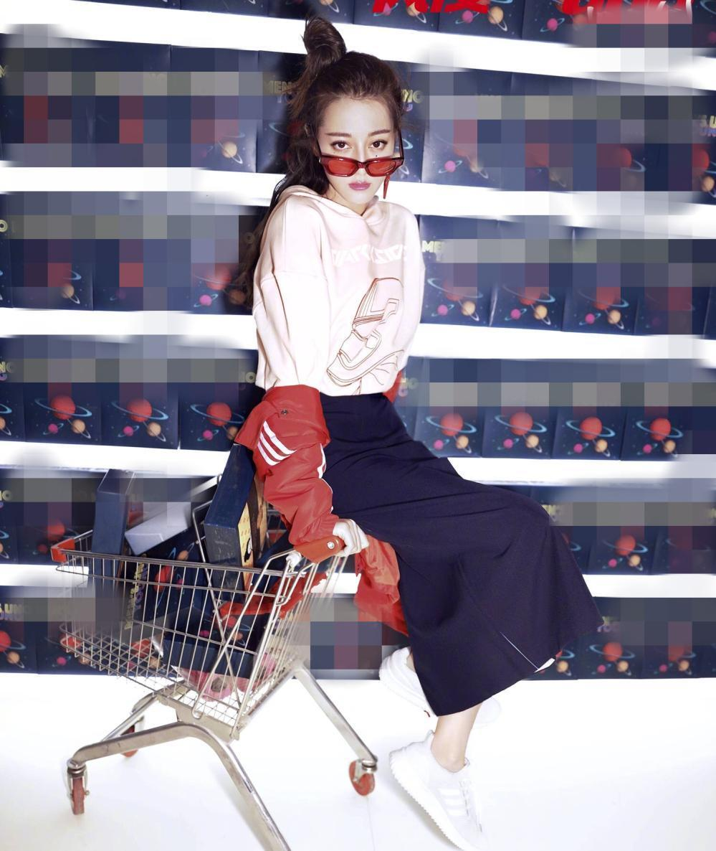
She was
at the supermarket yesterday.
迪麗熱巴Dilraba

Slide 29
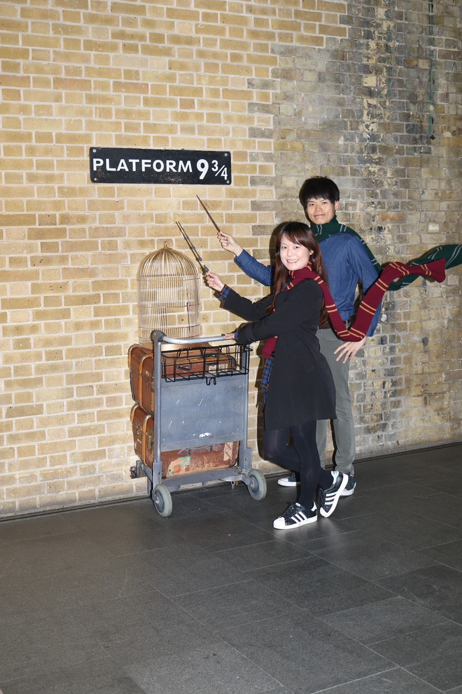
We were
at the
train station yesterday.

Slide 30
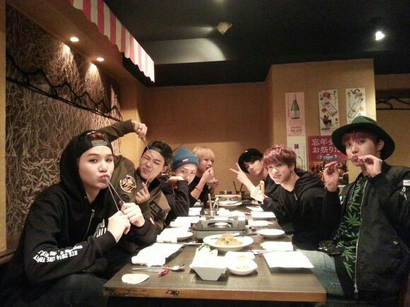
They were
at the restaurant yesterday.
防彈少年團BTS

Slide 31
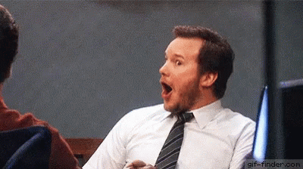

Slide 32
Was he
at home yesterday?

Slide 33
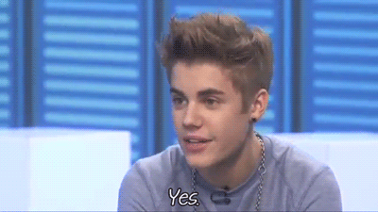
Yes, he was.
He was at home yesterday.

Slide 34
Was she
at the library yesterday?

Slide 35
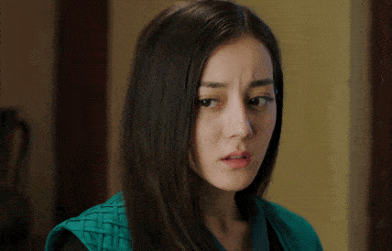
No, she wasn’t.
She was at the supermarket yesterday.

Slide 36
Were you
at the museum yesterday?

Slide 37
Yes, I was.
I was at the museum yesterday.

Slide 38
Were you
at the
post office yesterday?

Slide 39
No, we weren’t.
We were at the train station yesterday.

Slide 40
Were they
at the hospital yesterday?

Slide 41
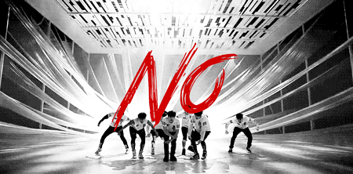
No, they weren’t.
They were at the restaurant yesterday.

Slide 42
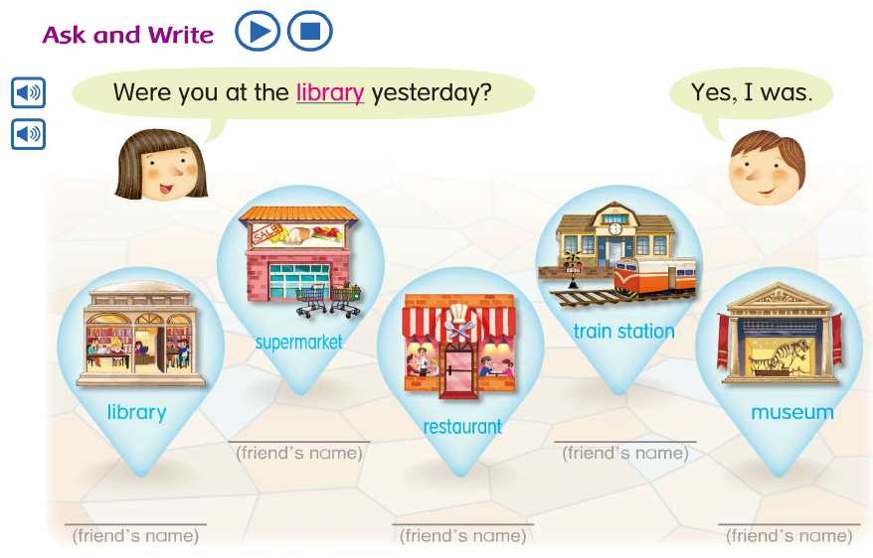

Slide 44
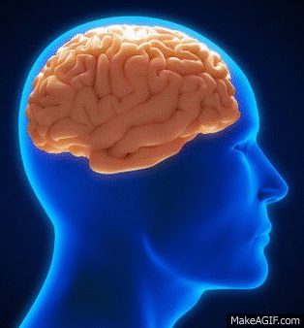
Memory challenge

Slide 45
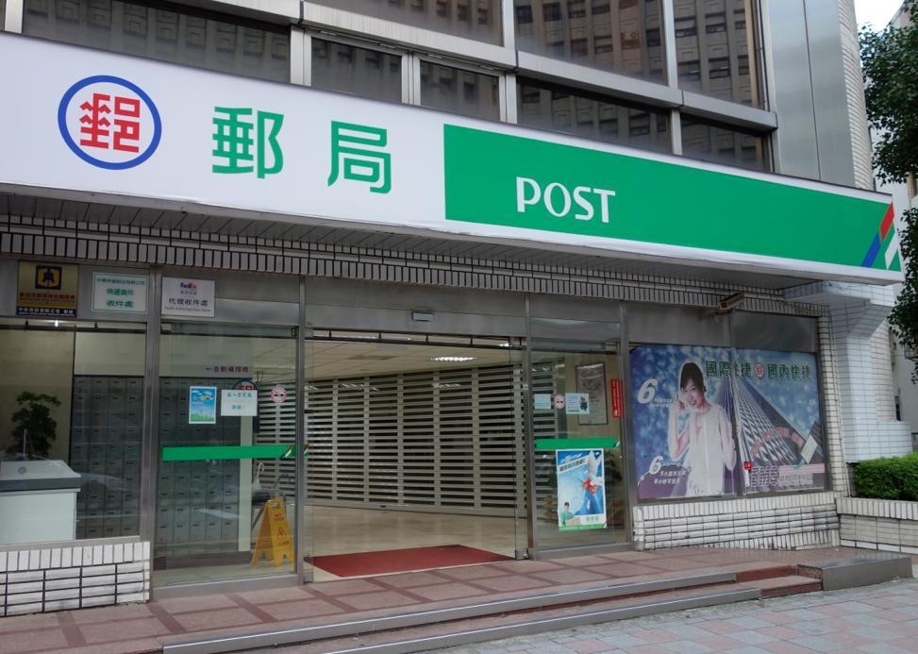

Slide 46
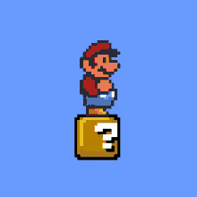
Q: Was JJ Lin at the post office yesterday?

Slide 47
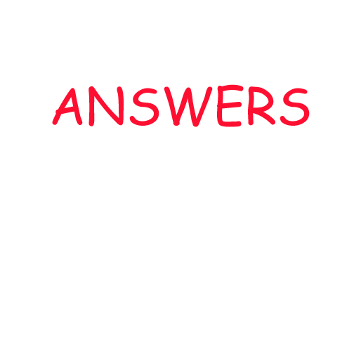
Yes, he was.
He was at the post office yesterday.

Slide 50
Q1: Was Tzu-Yu at the park yesterday?

Slide 52
Q2: Was Gong Yoo at the restaurant yesterday?

Slide 54
Q3: Were President Trump and President Tsai at the bookstore yesterday?

Slide 56
Q4: Was Stephan Curry at the park yesterday?

Slide 58
Q5: Was Conan at the restaurant yesterday?

